Slide 1
PERFORMING ARTS
DANCE

Slide 2
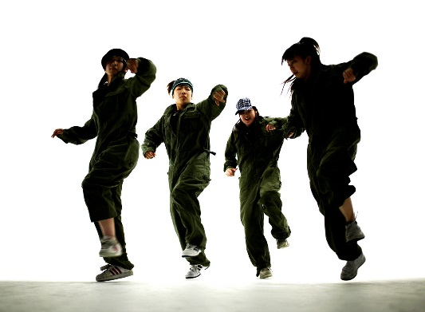
Learning Objective
To be able to participate in an effective warm showing focus, energy and determination.
To be able to learn a routine that uses the 5 basic actions and identify them!

Slide 3
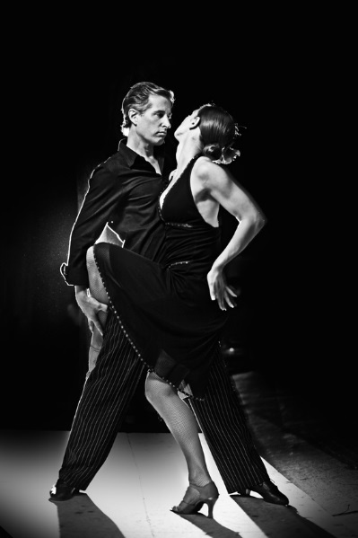
Success Criteria
STEP 3
Can focus in the warm and identify some pulse raisers.
Can reproduce the taught routine with a few errors.
STEP 4
Will focus and put effort in throughout the lessons and be able to identify the 3 sections of the warm up.
Will perform the routine with energy and focus.
STEP 5.
Will concentrate and perform to the best of their ability throughout the lesson and work hard to warm up effectively.
Will perform with focus and accuracy of movement and always be keen to improve.
STEP 6
Will be a role model to the group, work hard at all times and be proactive in asking and answering questions.
Will take a leadership role when rehearsing and help others to perform the routine.

Slide 4

FIZZ BUZZ
YOU HAVE TO JUMP FOR FIZZ AND SPIN FOR BUZZ
All pupils stand in a circle in the room. Go round the circle counting from one upwards, in number order. If a pupil says a multiple of 3 they JUMP and if they say a multiple of 5 they say SPIN. If they say a multiple of 3 and its also a multiple of 5 then they say JUMP AND SPIN at the same time.
Skills Required
Listening to others
Knowing your timetables
Thinking quickly
Concentrating
BE AWARE OF YOUR SPACE!

Slide 5
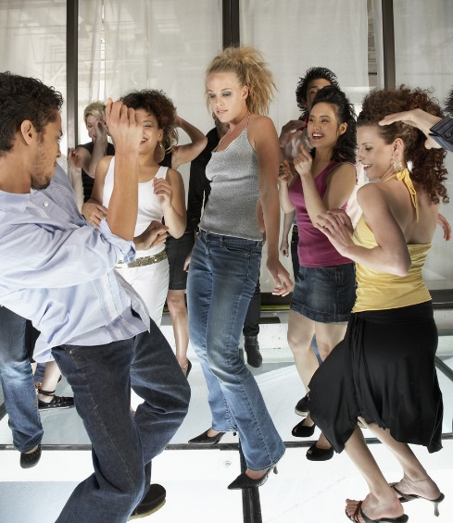
KEY WORDS
ACTION-WHAT
DYNAMIC-HOW
SPACE-WHERE
RELATIONSHIPS-WHO
RHYTHM-TIMING
FOCUS

Slide 6
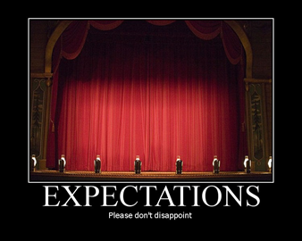

EXPECTATIONS
BE RESPECTFUL OF OTHERS IN THE CLASS.
TRY YOUR HARDEST AT ALL TIMES.
LISTEN TO FEEDBACK AND USE THIS CONSTRUCTIVELY TO IMPROVE YOUR PERFORMANCE.
LISTEN TO THE TEACHER AT ALL TIMES.
BE ABLE TO WORK AS A GROUP AND INDEPENDENTLY.
BE CREATIVE.
USE THE STAGE EFFECTIVELY.
LISTEN TO YOUR PEERS IDEAS

Slide 7

WARM UP RECAP
WHAT IS NEEDED TO WARM UP EFFECTIVELY?
A warm up has 3 sections-
Pulser raiser,
Co-ordination
stretch.
GIVE EXAMPLES OF EXERCISES YOU COULD USE

Slide 8
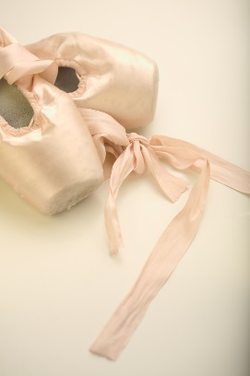
5 BASIC ACTIONS
The 5 basic actions are
Jump
Hop
Travel
Stillness/gesture
Turn/rotate

Slide 9
STREET DANCE-WHAT DO YOU KNOW?
We are now going to learn a short routine.
How many of the 5 basic actions can you identify?
REMEMBER TO COUNT!

Slide 10

EXTENSION TASK PERFORMANCE!
In 2 groups you will now perform the routine to each other.
LEVEL CHECK!
DON’T worry if you go wrong- carry on!

Slide 11
PLENARY
What have you learnt today?
Each corner of the room is a level. Go to the corner you think you are at and be ready to explain why and how you could improve.

